Slide 1
StudyPlanner Pro
The Ultimate GPA Booster
By Shijun Tian, Zyan Li, Qinyan Liu

Slide 2


Drowning in Deadlines?
Does your life feel like this?
•
Too many assignments?
•
Delaying DDLs till the last minute?
•
Zero time for video games?
It's time for a change.

Slide 3
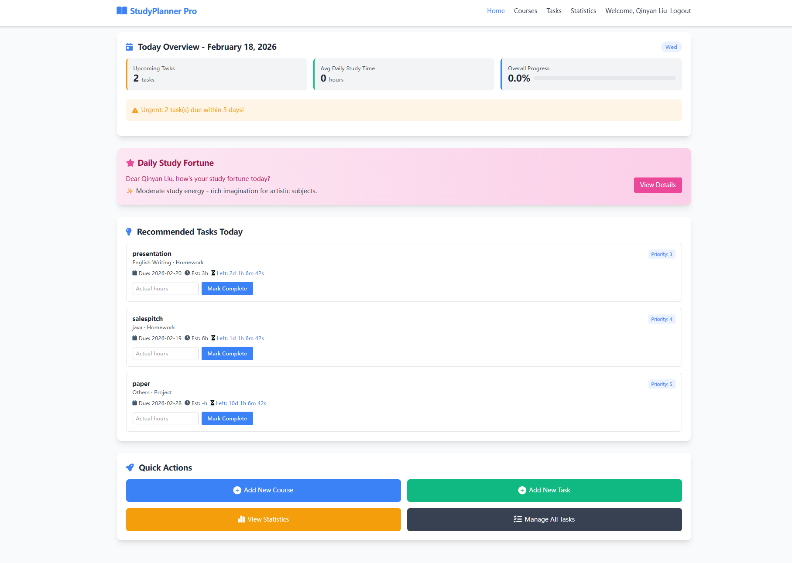


Meet Your New Best Friend
StudyPlanner Pro
The all-in-one tool designed to save your grades AND your social life.
Simple. Powerful. Fun.

Slide 4






Who Needs This?
Students
Gamers
Procrastinators
From High School to PhDs.
Finish homework fast, play more.
We organize the chaos for you.

Slide 5

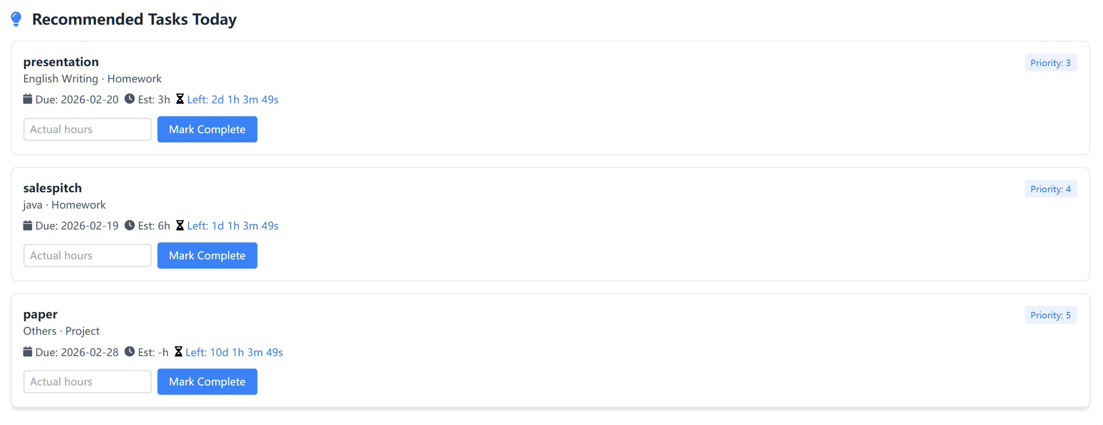
Task Master
Never miss a deadline again.
•
Color-coded priorities
•
Realtime countdown
•
"Check-off" progress bar

Slide 6


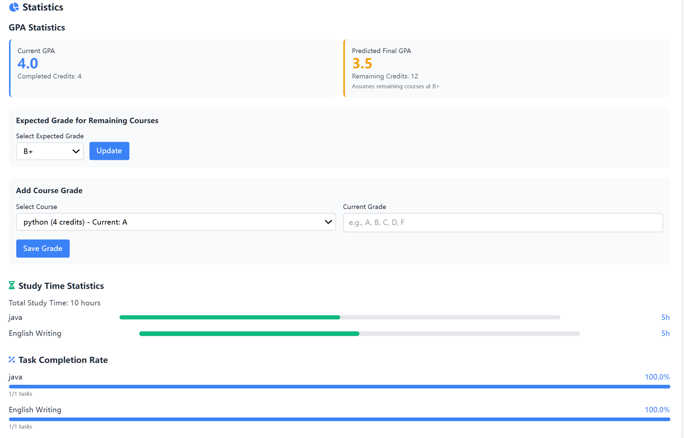


GPA Tracker
Track your GPA in real-time.
Know exactly what you need on the final exam to pass.

Slide 7
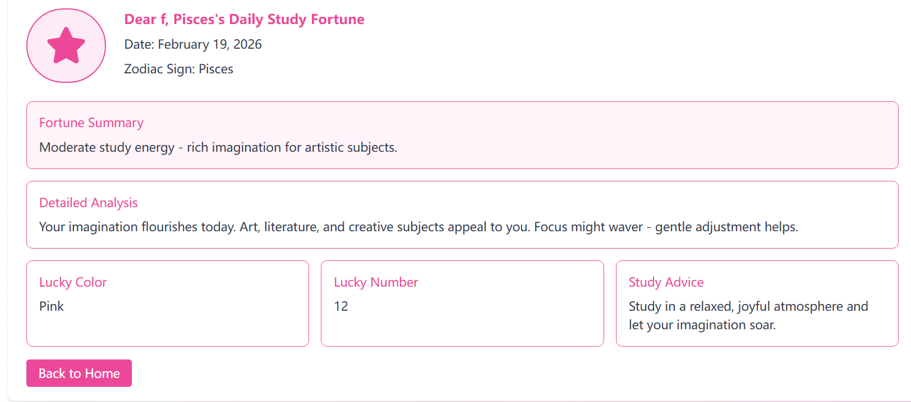



Luck for studies
The "Luck" Feature
Don't know what to study first?
Let fate decide! Get your lucky task based on your zodiac.
Gamify your study session!

Slide 8


Why Buy?
The Value of Time
StudyPlanner Pro saves you up to 5 hours a week.
That means more time for:
Sleeping 😴
Gaming 🎮
Actually having a life 🌟

Slide 9


Customer Feedback
"I used to fail math. Now I calculate the trajectory of my grades for fun."
"This app saves me so much time, I can easily plan my tasks and don’t worry about DDLs again."
- Justin Y.
- Cindy H.

Slide 10
The Price?
$49.9
Per Year

Slide 11

The Price?
$4.99
Per Year
(Cheaper than a latte!)
Free
for everyone here today!

Slide 12



Get It NOW!
Don't let another semester slip away.
Study Planner Pro
Make studying easier, more organized, and fun!
Task master
GPA Tracker
Fortune-teller for studies

